Slide 1
Soccer Player Performance Analysis & Business Case Applications
Data-Driven Decision Making for Scouting, Transfers, and Financial Optimization

Slide 2
Overview
Key Metrics from the Dashboard:
Highest Overall Rating: Cristiano Ronaldo (94), Lionel Messi (93), Luis Suárez (92).
Best Value-for-Money Players: Marlos, Taison, D. Srna (Performance-to-Wage Ratio: 0.08).
Top Club Performance: FC Barcelona leads with an average rating of 82.56.
Market Value Leaders: Neymar (€123M), Messi (€105M), Suárez (€97M).
Transfer Risk Assessment: Identifying high-wage, low-performance players for strategic transfers.
Age Group Trends: Prime players (24-30) have the highest market value (€15M), while young players (<23) show strong growth potential.

Slide 3
Data Methodology
Data Sources: Player statistics from CSV files, SQL queries, and Power BI analysis.
Processing Steps:
Data cleaning and preparation in Excel.
SQL queries for key metrics (KPIs).
Power BI visualizations for interactive analysis.

Slide 4
Business Use Case – Player Scouting
Objective: Identify high-potential players based on market value, performance, and future growth.
Insights from Power BI:
Top Performing Players: Cristiano Ronaldo (94), Lionel Messi (93), Luis Suárez (92).
Best Young Talents: A. Gomes, C. Gregory with high growth potential.
Market Value Trends: Young players (<23) with low market value and high potential are ideal scouting targets.
Key Metrics: Growth potential, market value fluctuations, scouting recommendations.

Slide 5
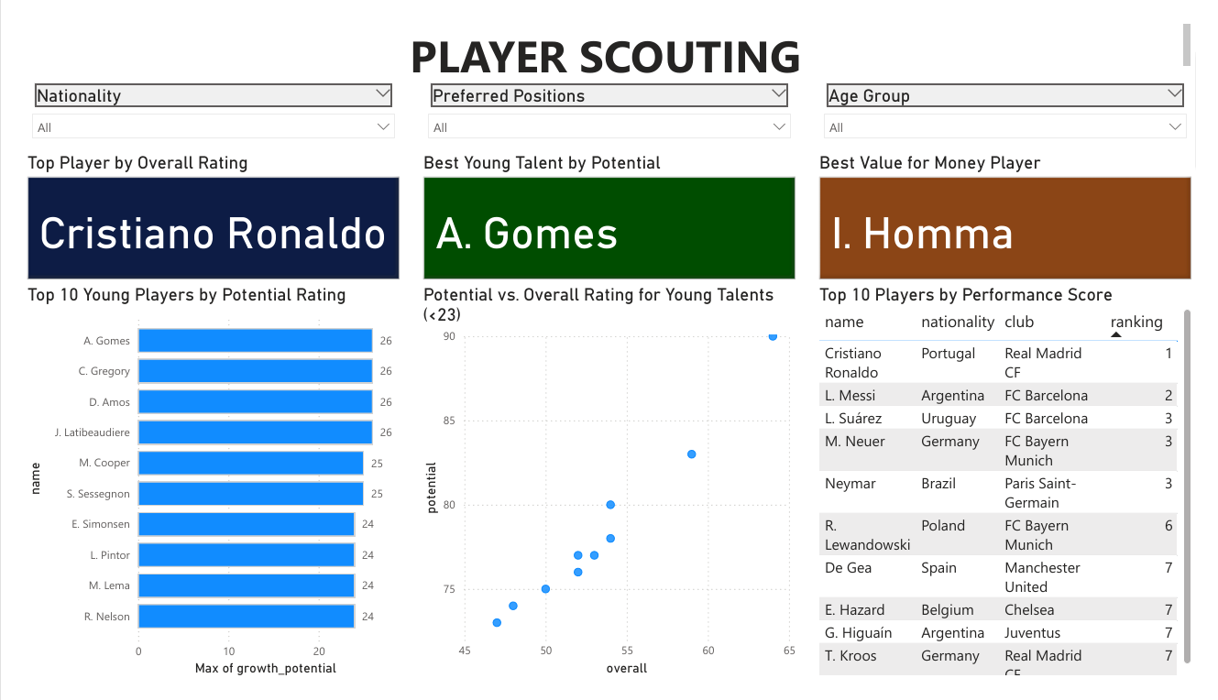

Slide 6
Business Use Case – Performance Analysis
Objective: Optimize squad formations based on performance trends and positional efficiency.
Insights from Power BI:
Most Effective Positions: ST, CM, and LW/RW have highest impact.
Physical Attributes & Play Style: Acceleration and agility correlate with dribbling ability (0.70 correlation score).
Age-Based Performance Trends: Midfielders peak early; defenders and goalkeepers have longer career longevity.
Performance Score Trends: Identifies consistency and peak performance levels by player.

Slide 7
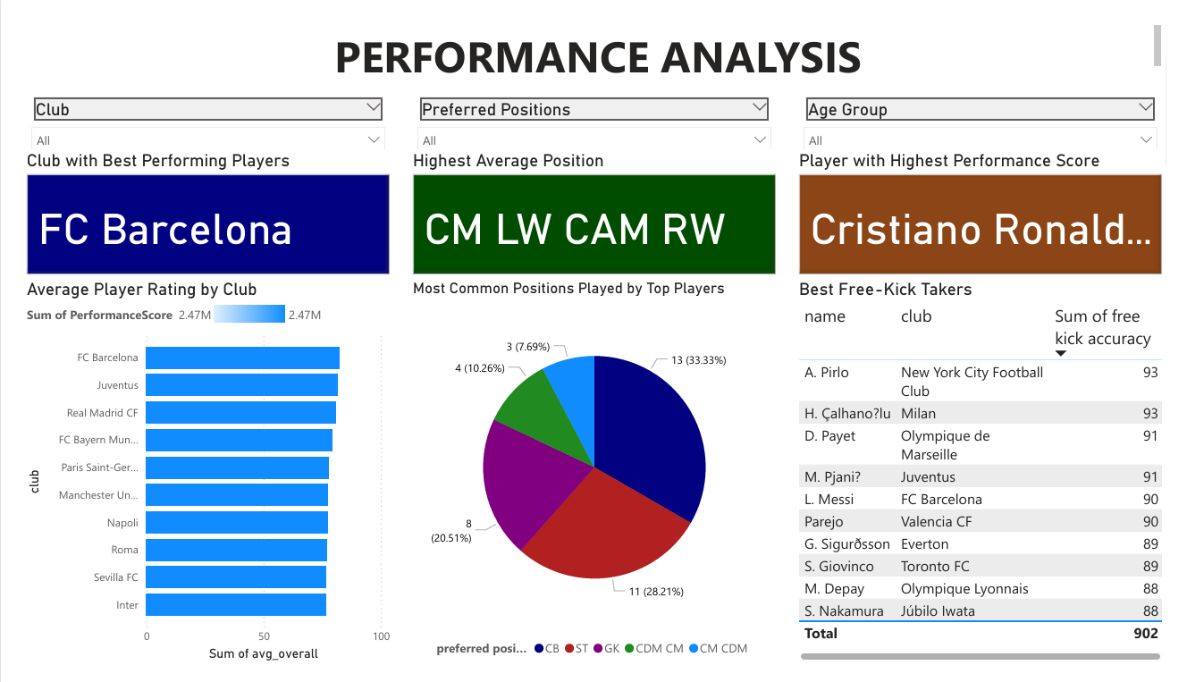

Slide 8
Business Use Case – Injury Prevention
Objective: Reduce injury risks through data-driven player fitness assessments.
Insights from Power BI:
Players with Highest Agility & Acceleration: Douglas Costa, Gelson Martins.
Correlation Between Physical Attributes & Injury Risk: Tracking player endurance & workload impact.
Age-Based Injury Trends: Older players require specialized recovery programs.
Recommendation: Clubs should implement load management strategies for players at risk

Slide 9
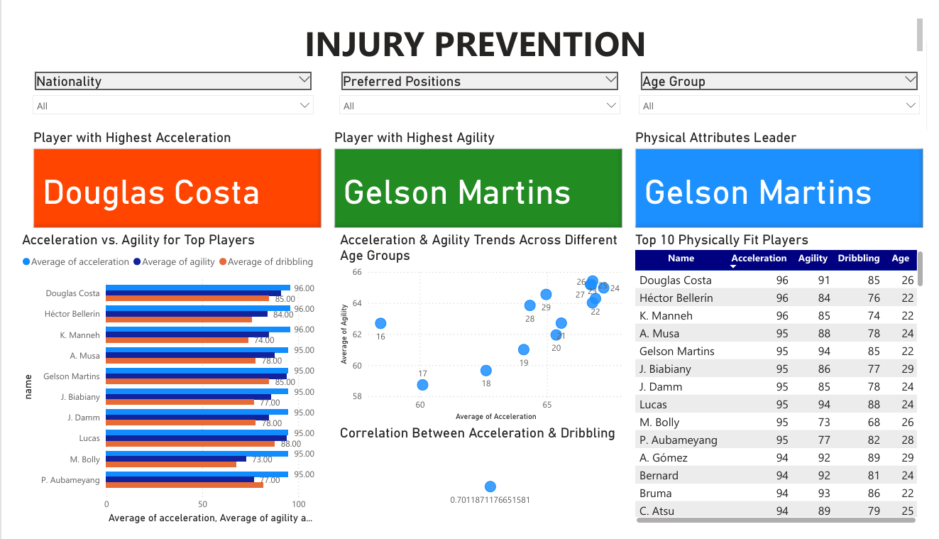

Slide 10
Business Use Case – Fan Engagement & Marketing
Objective: Use player analytics to enhance fan engagement and increase revenue.
Insights from Power BI:
Most Marketable Players: High-performing players with social influence (Cristiano Ronaldo, Lionel Messi, Neymar).
Emerging Stars: Young talents with high potential can be used in branding strategies.
Set-Piece Specialists: Highlighted players with the best free-kick accuracy (Pirlo, Messi, Çalhanoğlu) for promotional campaigns.
Engagement Strategies: Leverage player data for sponsorships, merchandise sales, and targeted marketing campaigns.

Slide 11
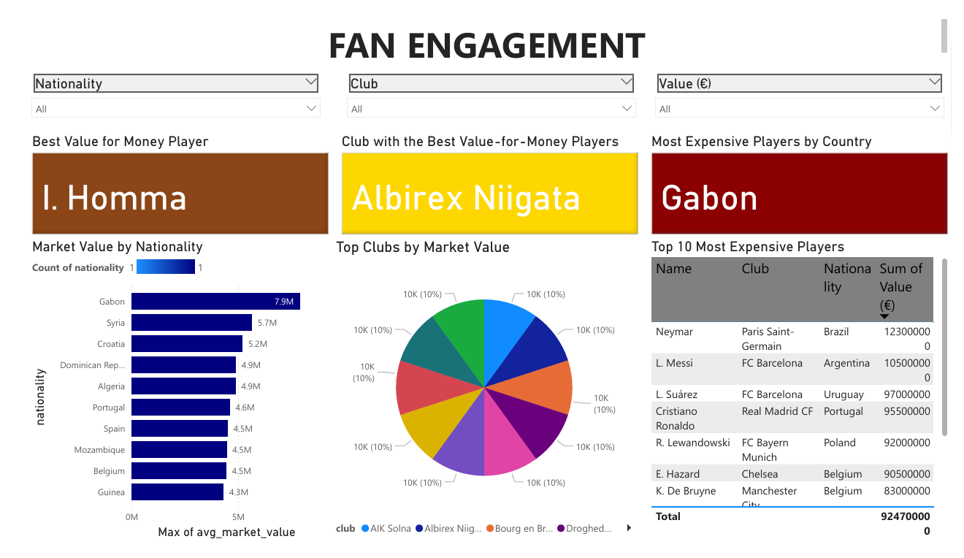

Slide 12
Business Use Case – Contract Negotiation
Objective: Optimize salary structures and retain high-value players efficiently.
Insights from Power BI:
Wage-to-Performance Ratio: Identifies overpaid vs. underpaid players.
Highest Paying Leagues: Premier League (€170K avg. wage), La Liga (€150K avg. wage), Bundesliga (€120K avg. wage).
Salary Efficiency by Position: ST and CM positions offer the best return on investment.
Recommendation: Adjust salaries based on performance trends to optimize financial resources.

Slide 13
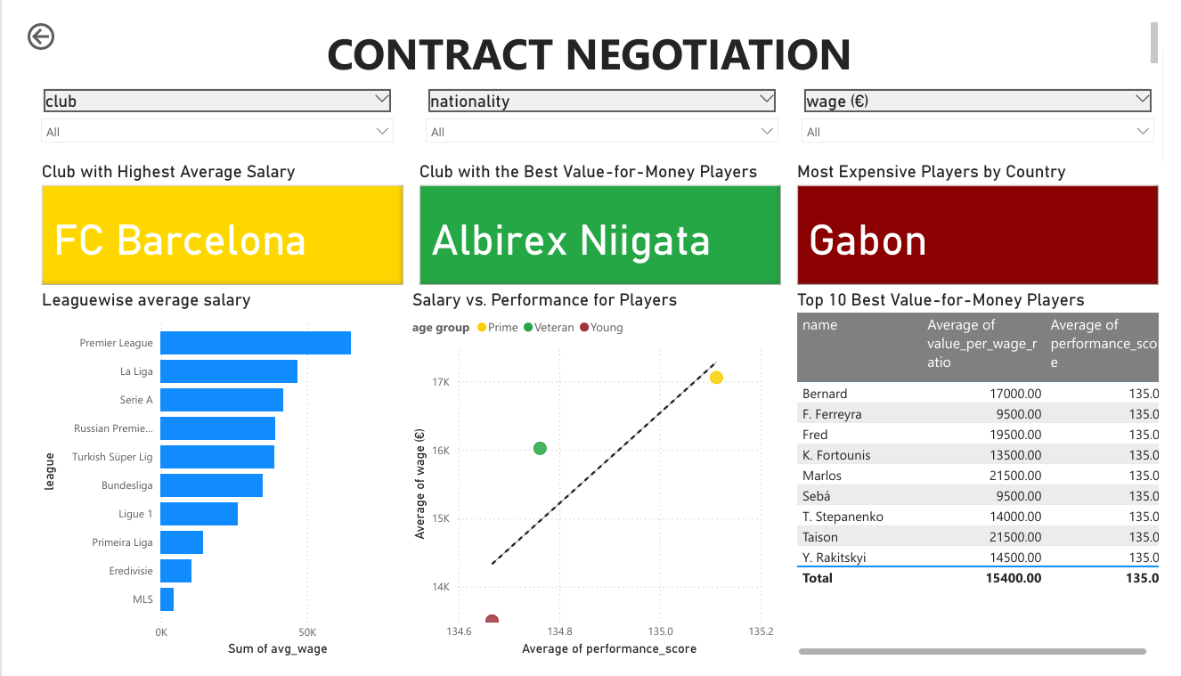

Slide 14
Business Use Case - Age Group Trends
Objective: Understand performance development across different age groups.
Insights from Power BI:
Peak Performance Windows: Prime-age players (24-30) have the highest market value (€15M).
Young Player Development: Players under 23 show the highest growth potential.
Veteran Performance Sustainability: Players over 30 remain valuable but require strategic usage.
Strategic Recommendation: Clubs should invest in younger players with high potential and manage veteran workload effectively.
Top Performing Players: Cristiano Ronaldo (94), Lionel Messi (93), Luis Suárez (92).
Best Young Talents: A. Gomes, C. Gregory with high growth potential.
Market Value Trends: Young players (<23) with low market value and high potential are ideal scouting targets.

Slide 15
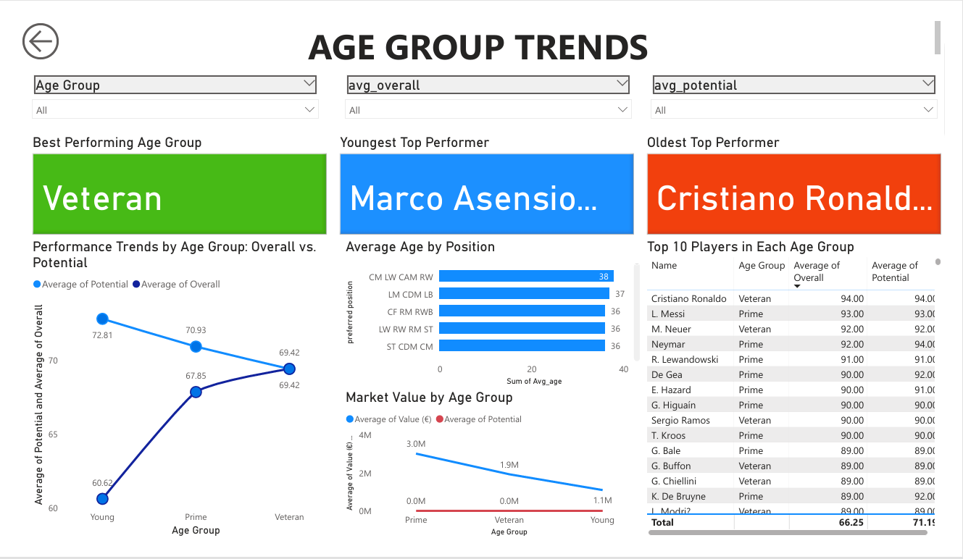

Slide 16
Business Recommendations for Clubs
Scouting Strategy: Invest in undervalued high-performing young players.
Contract Negotiation: Adjust salaries based on wage-to-performance efficiency.
Financial Planning: Optimize wage budgets using data-driven insights.
Transfer Decision-Making: Identify players who are overpaid or underperforming for potential transfers.
Fan Engagement Strategies: Market emerging players to boost audience engagement and revenue.

Slide 17
Conclusion & Next Steps
Utilize AI-driven forecasting for recruitment and contract decisions.
Monitor wage efficiency and market value trends for better financial planning.
Use performance insights to strengthen scouting, transfers, and sponsorship opportunities.

